Slide 1
Enzymes

Slide 2
What Are Enzymes?
Most enzymes are Proteins
They act as a catalyst to accelerate (speed up) a reaction
Enzymes are not permanently changed in the process

Slide 3
Two functions of enzymes
Dehydrations Synthesis
To build (synthesis) a polymer you must first remove some water (dehydrate it)
2. Hydrolysis
To break (lysis) a polymer you must add water (Hydro)

Slide 4
Dehydration Synthesis (Building polymers)
Dehydration Synthesis: Removal of water to make a bond
This is how you make muscles in your body. Muscles are made by combining two amino acids together to make protein. Proteins make up your muscles.

Slide 5
Hydrolysis (Breaking Polymers)
Hydrolysis: Addition of water to break a bond
This is how you digest your food. The polymers are broken down into their monomer groups. Think of the cracker.

Slide 6
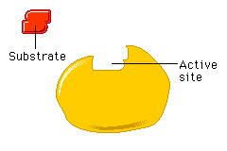
Enzymes
Enzymes are specific for what they will catalyze
They are Reusable
All enzyme names end in –ase
-Sucrase
-Lactase
-Maltase

Slide 7
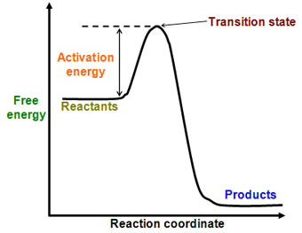
How do enzymes work?
Enzymes work by weakening bonds which lowers activation energy

Slide 8
Enzymes
Without Enzyme
With Enzyme
Free
Energy
Free energy of activation
Reactants
Products
Progress of the reaction

Slide 9
Active Site
The active site is a restricted region of an enzyme molecule where the substrate binds
Active Site
Substrate
Enzyme

Slide 10
Enzyme-Substrate Complex
The enzyme substrate complex is a temporary molecule formed when an enzyme comes into perfect contact with its substrate
Substrate
Joins
Enzyme

Slide 11
What Affects Enzyme Activity?
Three factors:
1. Temperature
2. pH
3. Enzyme inhibitors

Slide 12
1. Temperature
Extreme temperatures are the most dangerous
high temperatures may denature the enzyme.
When an enzyme is denatured, its active site is changed

Slide 13
Denatured Enzyme

Slide 14
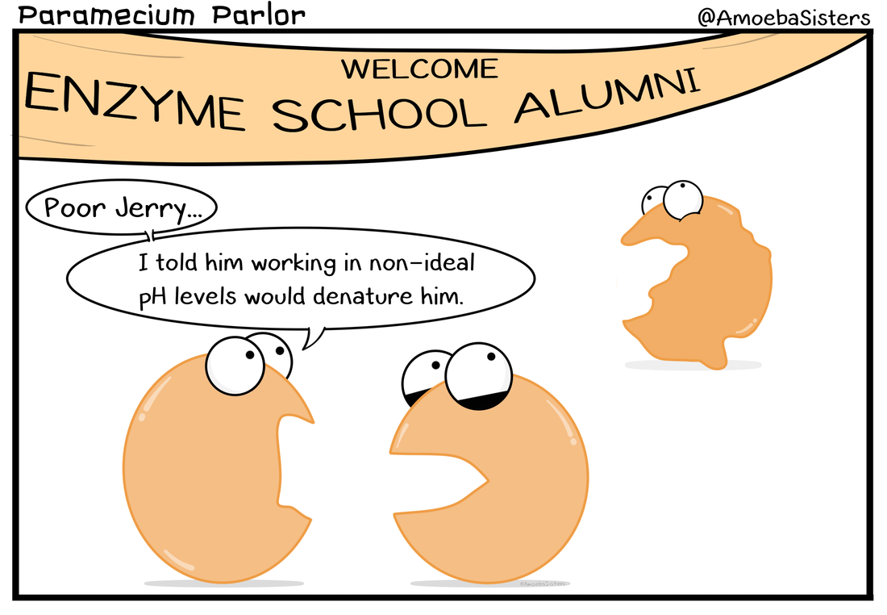
2. pH
Changes in pH also change the shape of an enzyme's active site.
Each enzyme work bests at a specific pH value

Slide 15
3. Enzyme Inhibitors
Enzyme inhibitors: Are chemicals that resemble an enzyme’s normal substrate and compete with it for the active site.
Substrate
Enzyme
Competitive inhibitor

