Slide 1
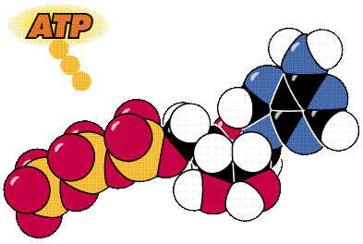
What Is ATP?
Energy used by all cells
Adenosine TriPhosphate
Organic molecule containing high-energy phosphate bonds

Slide 2
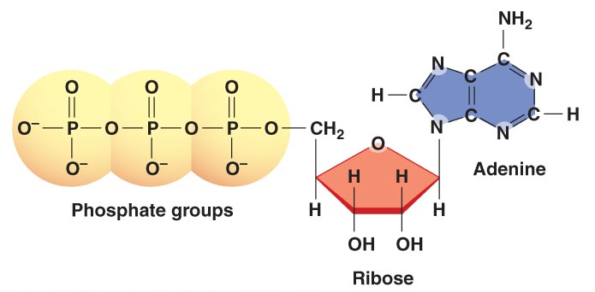
Chemical Structure of ATP
Base
3
Sugar

Slide 3
What Does ATP Do for You?
It supplies YOU with ENERGY!

Slide 4
How Do We Get Energy From ATP?
By breaking the high- energy bonds between the last two phosphates in ATP

Slide 5
What is the Process Called?
HYDROLYSIS (Adding H₂O to break a bond)

Slide 6
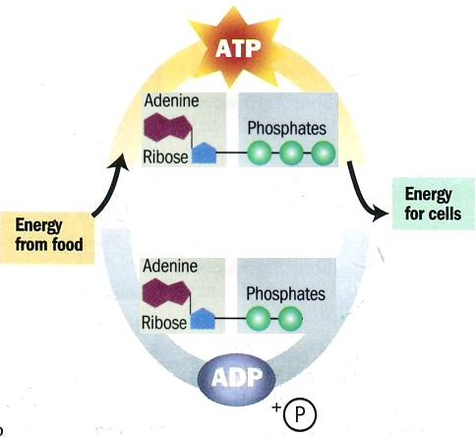
What do you need to break down ATP?
An Enzyme!
ATPase

Slide 7
What do you need to make ATP?
The reverse of the previous process occurs.
Another Enzyme is used!
ATP Synthase

Slide 8
The ADP-ATP Cycle
ATPase
ATP Synthase

Slide 9
When is ATP Made in the Body?
During a Process called Cellular Respiration that takes place in both Plants & Animals

Slide 10
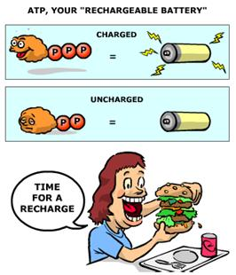
ATP Cartoon
Create a cartoon (Use www.canva.com) showing how ADP and ATP work in a cell.
Include the following:
ATP
ADP
P (phosphate)
ATPase & ATP synthase
Energy

