Slide 1
Properties of Water lab

Slide 2
Create the following table in your notebooks.
Know | Want to Know | Learned

Slide 3
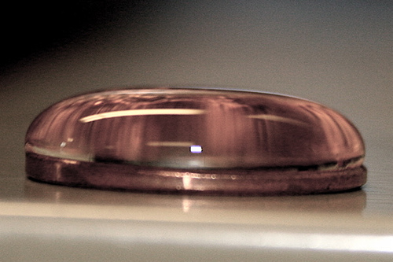
Know
In the KWL chart, describe what you know about this picture and the properties of water being displayed
Think, what makes water mound up like this?

Slide 4
Want to know
In the KWL chart, describe what you want to know about this picture and the properties of water being displayed- or anything else dealing with water!!!
Think, what makes water mound up like this?

Slide 5
Properties of Water Activity
Why is water so important to life? What makes it so special?
Take 3 minutes as a group and come up with 3 reasons why water is important to life.
1.
2.
3.

Slide 6
Learned
In the KWL chart, research questions and write the answers in the learned portion on the KWL chart
Think, what makes water mound up like this?

Slide 7
The lab Notes
Cohesion: Attraction between molecules of the same substance
Adhesion: The force of attraction between two different substances
Surface Tension: A property of the surface of a liquid that allows it to resist an external force
Covalent Bond: A chemical bond between two atoms when they share electrons

