Slide 1
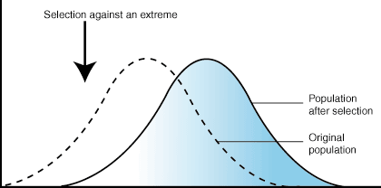
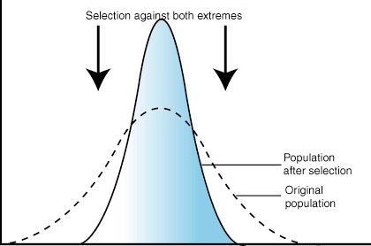
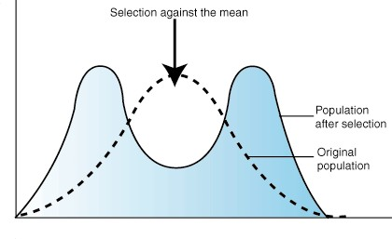
Three Types of natural selection
B
A
Directional Selection
C
Stabilizing Selection
Disruptive Selection

Slide 2
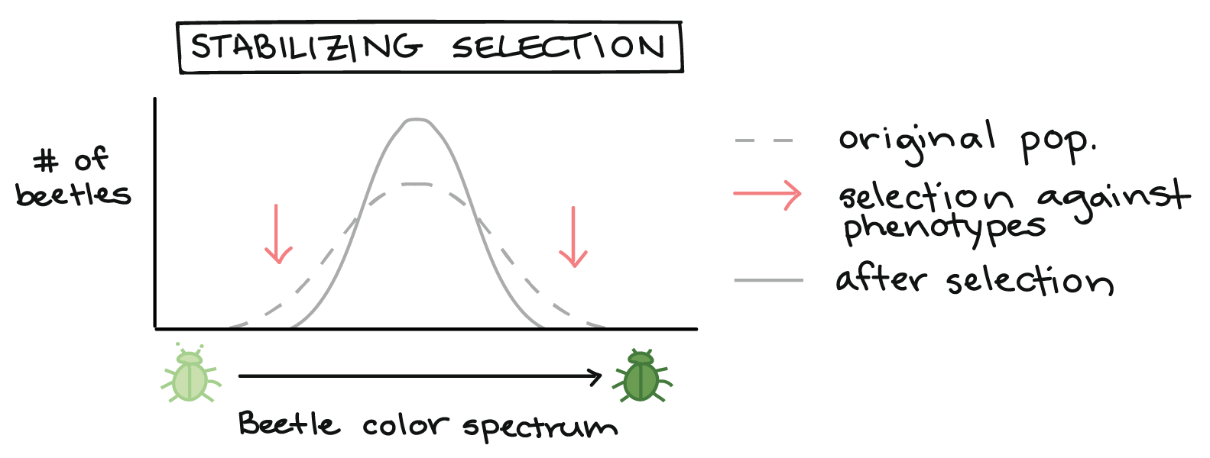
A. Stabilizing Selection
Stabilizing selection. In stabilizing selection, intermediate phenotypes are more fit than extreme ones. For example, medium-green beetles might be the best camouflaged, and thus survive best, on a forest floor covered by medium-green plants. Stabilizing selection tends to narrow the curve.

Slide 3
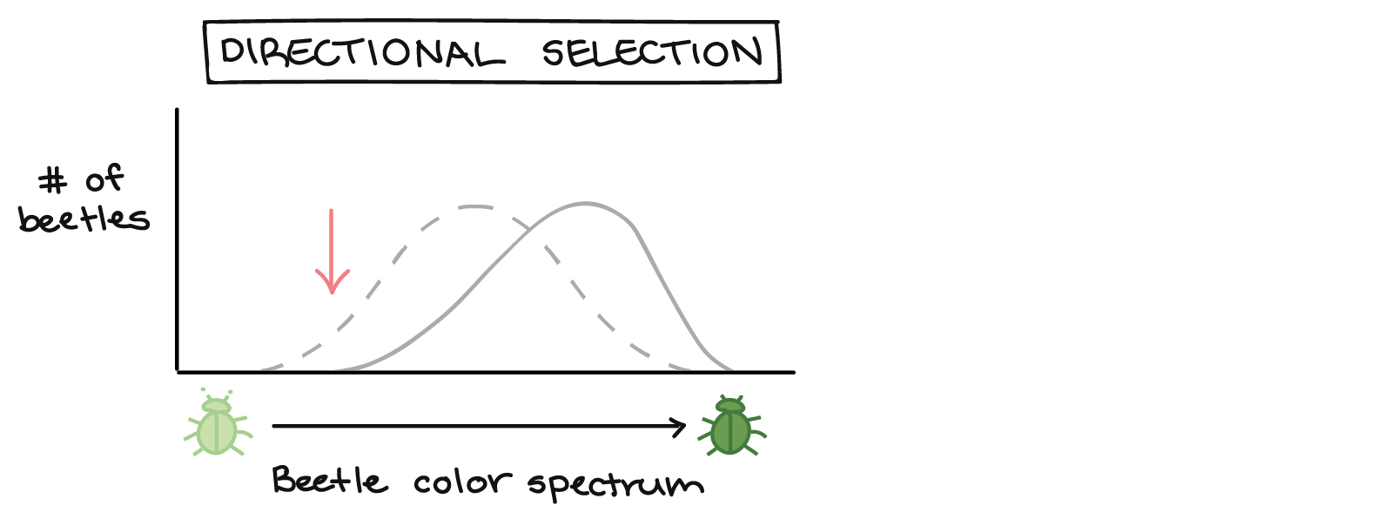
B. Directional Selection
Directional selection. One extreme phenotype is more fit than all the other phenotypes. For example, if the beetle population moves into a new environment with dark soil and vegetation, the dark green beetles might be better hidden and survive better than medium or light beetles. Directional selection shifts the curve towards the favorable phenotype.

Slide 4
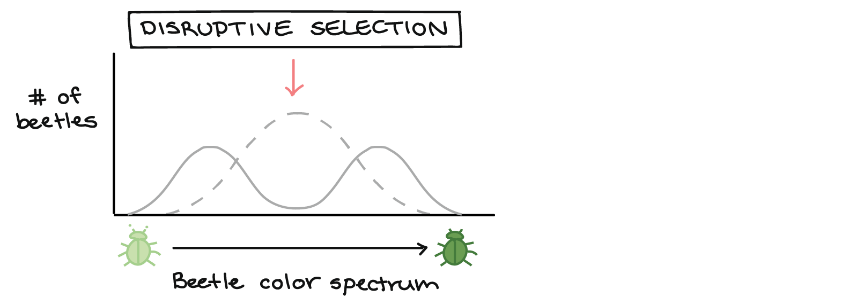
C. Disruptive Selection
Disruptive selection. Both extreme phenotypes are more fit than those in the middle. For example, if the beetles move into a new environment with patches of light-green moss and dark-green shrubs, both light and dark beetles might be better hidden (and survive better) than medium-green beetles. Diversifying selection makes multiple peaks in the curve.

Slide 5
Populations become isolated when there is no gene flow.
Isolated populations adapt to their own environments.
Genetic differences can add up over generations.
Speciation is the rise of two or more species from one existing species.

Slide 6
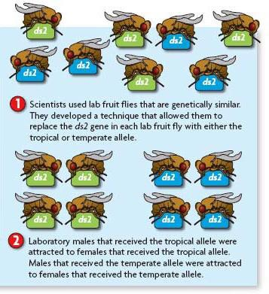
Reproductive isolation can occur between isolated populations.
members of different populations cannot mate successfully
final step to becoming separate species

Slide 7
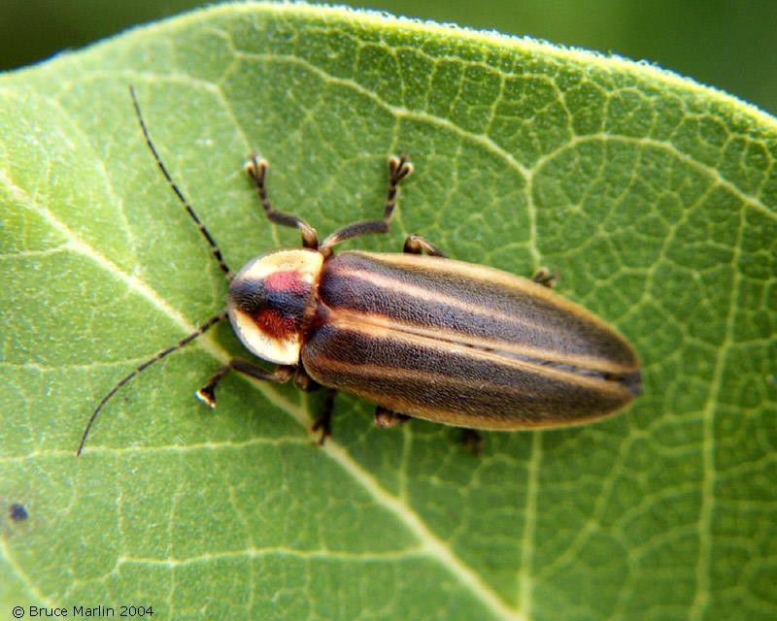
Behavioral barriers can cause isolation.
called behavioral isolation (1.)
includes differences in courtship or mating behaviors
Male and female fireflies produce patterns of flashes that attract mates of their own species.
Photuris frontalis – one flash every sec
Photuris hebes – one flash every 2 sec
Photuris fairchildi – one flash every
5.5 sec

Slide 8
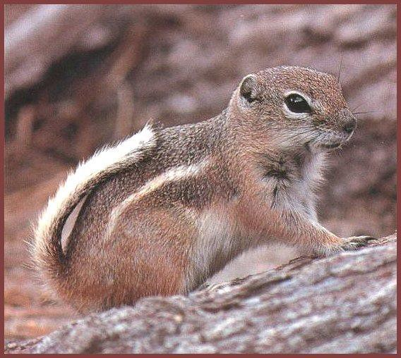
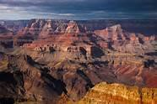
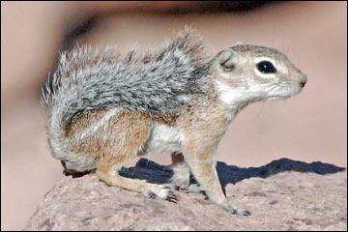
Geographic barriers can cause isolation.
called geographic isolation (2.)
physical barriers divide population
Grand Canyon
White-Tailed Antelope Squirrel
Ammospermophilus Leucurus
Harris Ground Squirrel
Ammospermophilus harrisii
• Temporal barriers can cause isolation.
– called temporal isolation (3.)
– timing of reproductive periods prevents mating

Slide 9
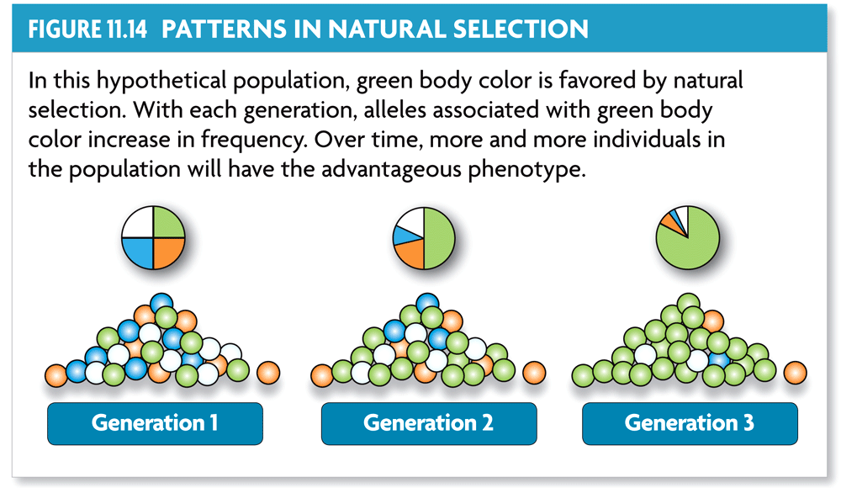
Natural selection can have direction.
The effects of natural selection add up over time.

Slide 10
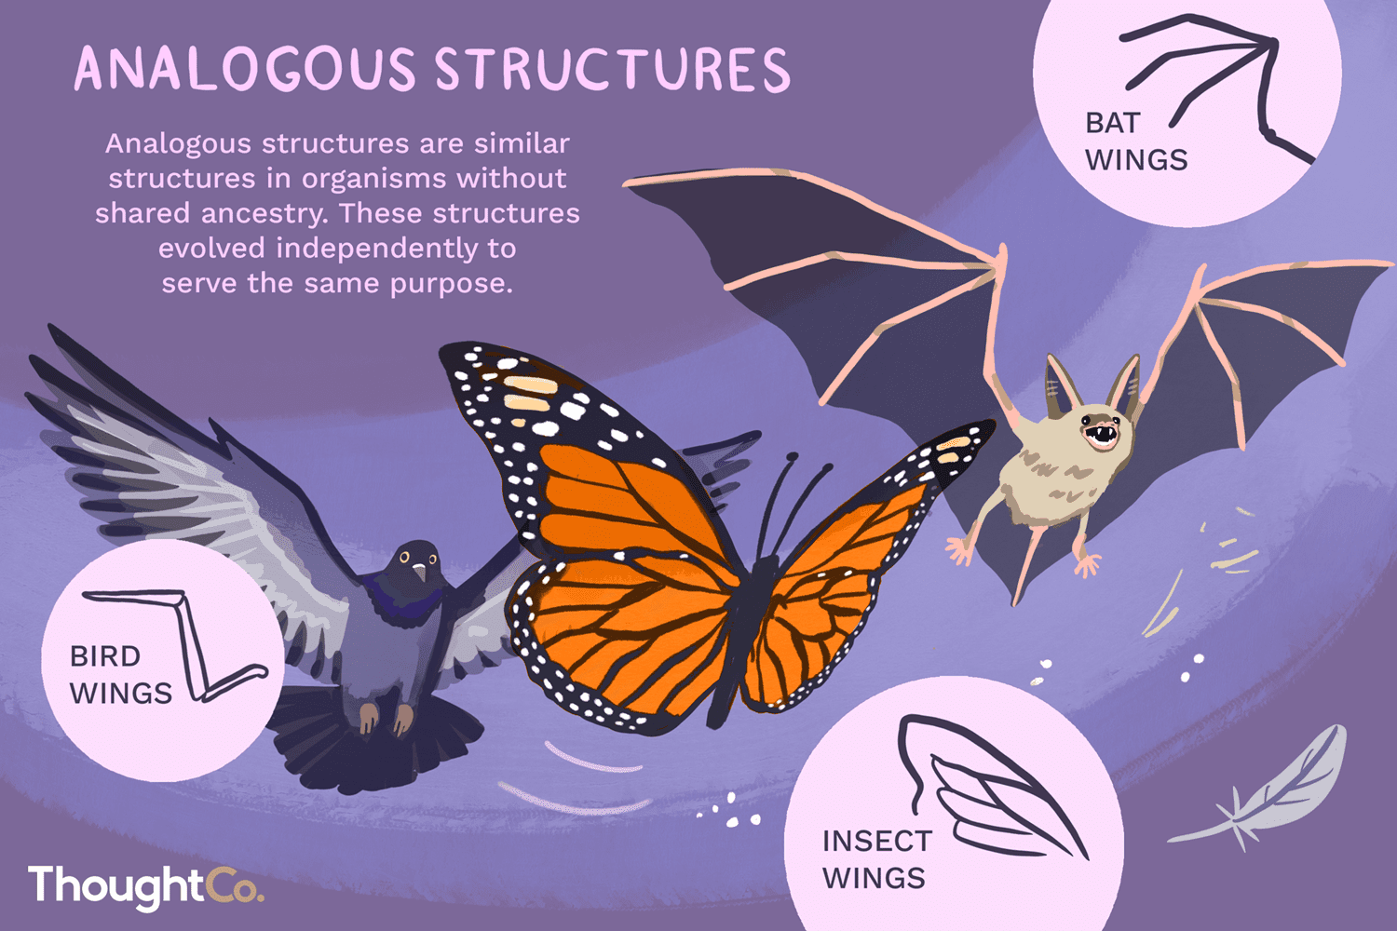
Convergent evolution describes evolution toward similar traits in unrelated species.
Example of Analogous structures: wings of birds and wings of bats or the tail fin of a shark and of a dolphin.

Slide 11
2. Divergent evolution describes evolution toward different traits in closely related species.
Closely related species become increasingly different.
Ex. Darwin’s finches, dogs, ancient horse

Slide 12
Two or more species can evolve together through coevolution.
evolutionary paths become connected
species evolve in response to changes in each other

Slide 13
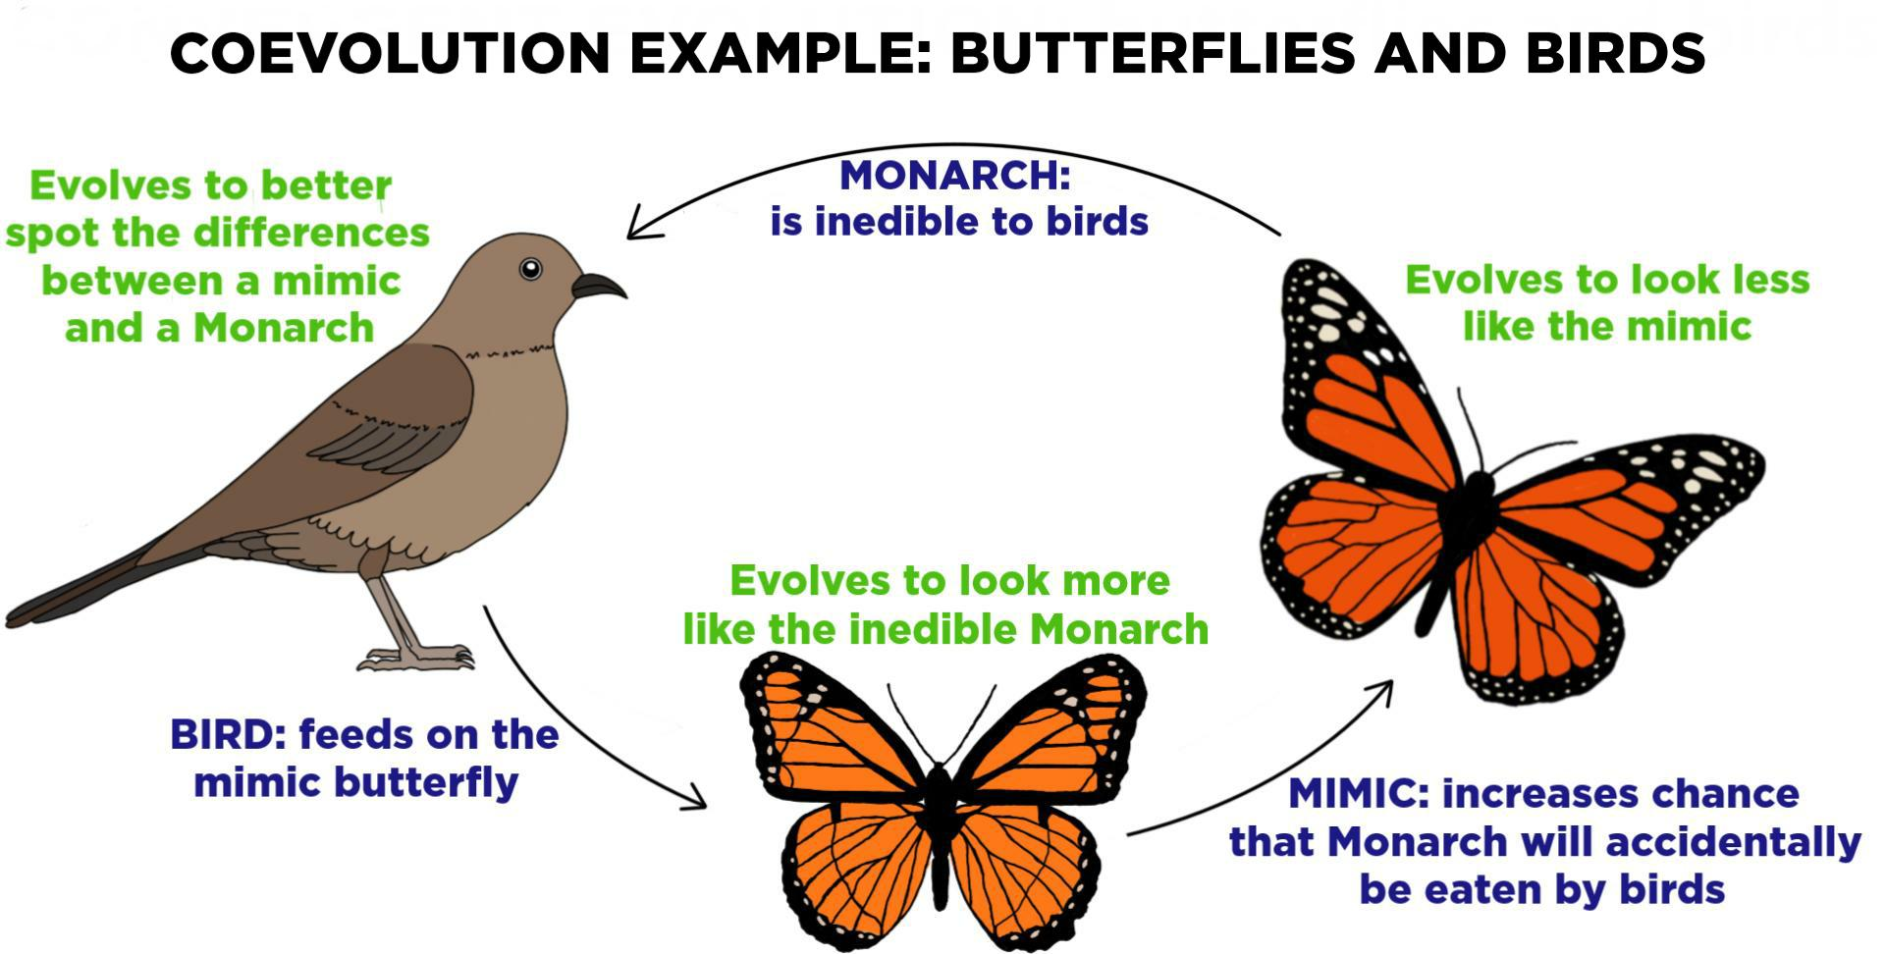
Coevolution can occur in beneficial relationships.

Slide 14
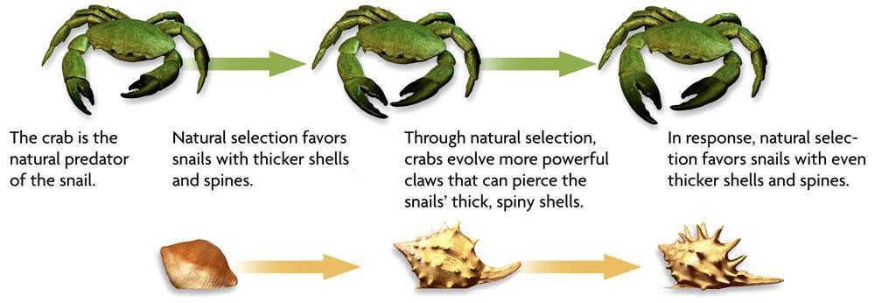
Coevolution can occur in competitive relationships, sometimes called an evolutionary arms race.
Why is this called an Evolutionary arms race?

Slide 15
1. The crab is a natural predator of the snail.
Natural selection favors snails with thicker shells.
Crabs evolve more powerful claws.
Snails evolve thicker shells and spines.

Slide 16
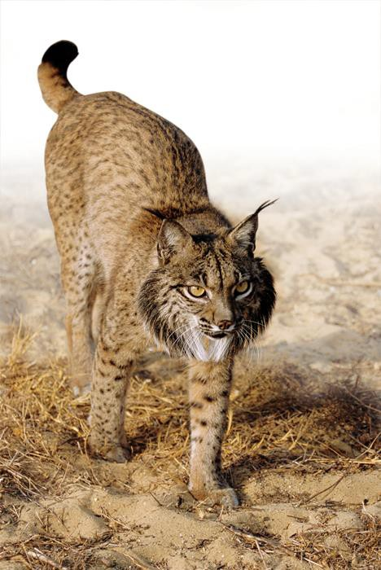
Extinction is the elimination of a species from Earth.
Background extinctions occur continuously at a very low rate.
occur at roughly the same rate as speciation
usually affects a few species in a small area
caused by local changes
in environment

Slide 17
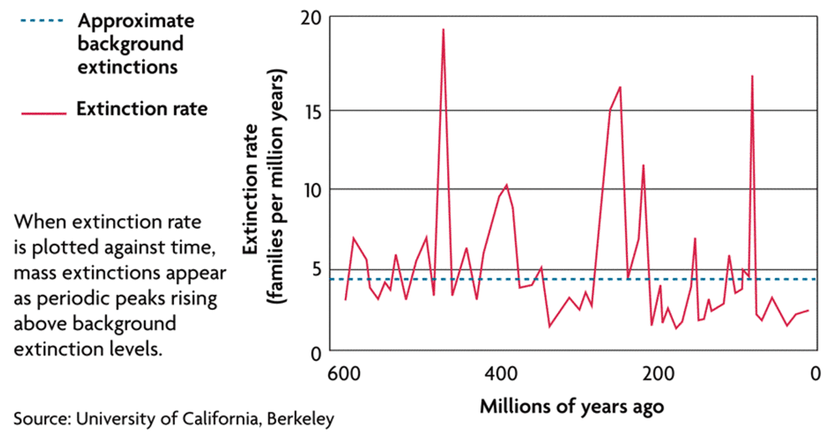
Mass extinctions are rare but much more intense.
destroy many species at global level
thought to be caused by catastrophic events
at least five mass extinctions in last 600 million
years

Slide 18
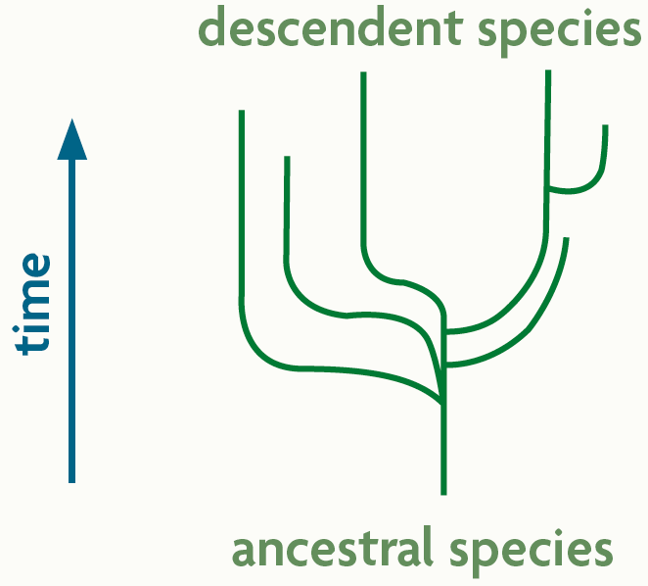
A pattern of punctuated equilibrium exists in the fossil record.
Episodes (bursts) of speciation occur suddenly in geologic time followed by long periods of little evolutionary change
Many species evolve from one species during adaptive radiation.
ancestral species diversifies into many descendent species
descendent species usually adapted to wide range of environments

