Slide 1
Biochemistry Unit

Slide 2
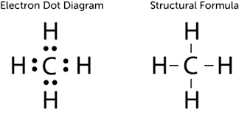
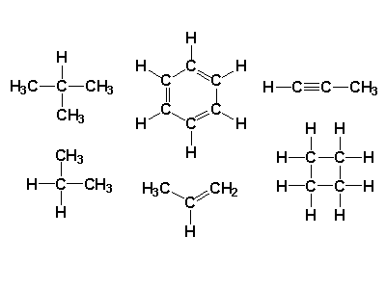
Carbon Compounds
A carbon atom can form four bonds with other atoms

Slide 3
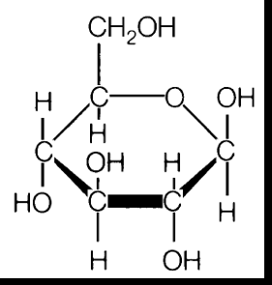
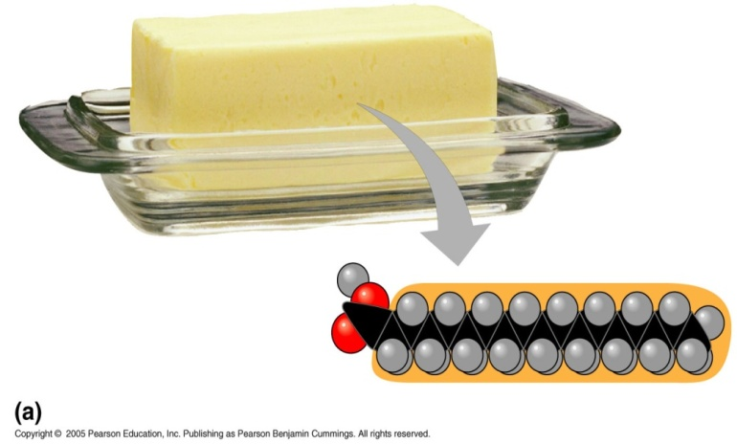
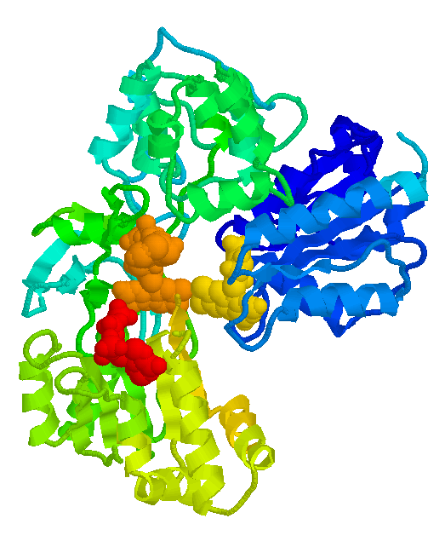
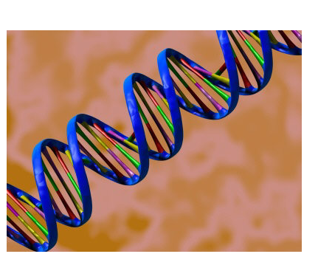
Carbon Compounds
Organic chemistry is the study of all compounds that contain bonds between carbon atoms.
Carbohydrates
Lipids (Fats)
Nucleic Acids (DNA)
Proteins

Slide 4
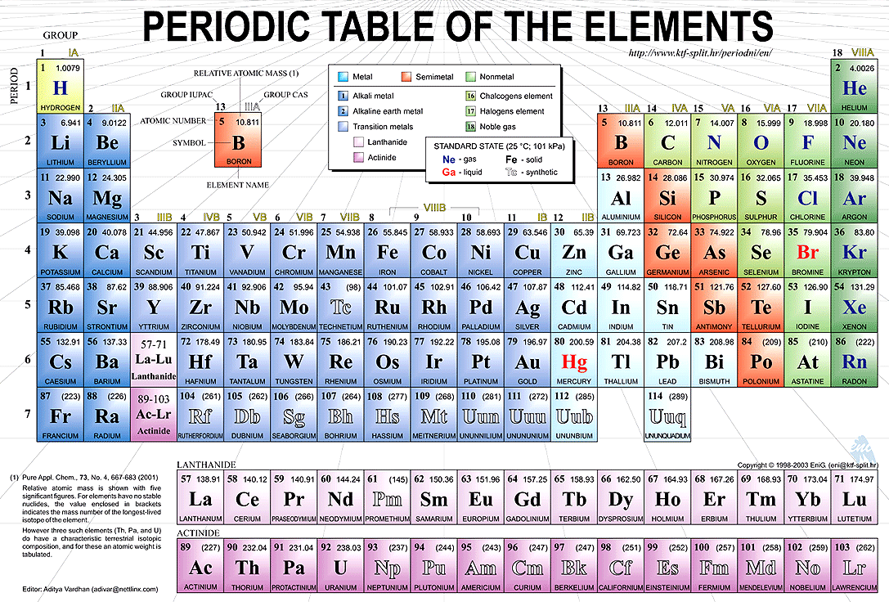
These elements are most common in our cells
Carbon (C), Hydrogen (H), Nitrogen(N), Oxygen(O), Phosphorus(P), and Sulfur(S).
Remember CHNOPS!

Slide 6
Macromolecules
Macromolecules: large molecules (Polymers) that are formed by joining smaller organic molecules (Monomers) together
Macromolecules are examples of polymers which form when many smaller molecules (called monomers) bond together, usually in long chains.

Slide 7
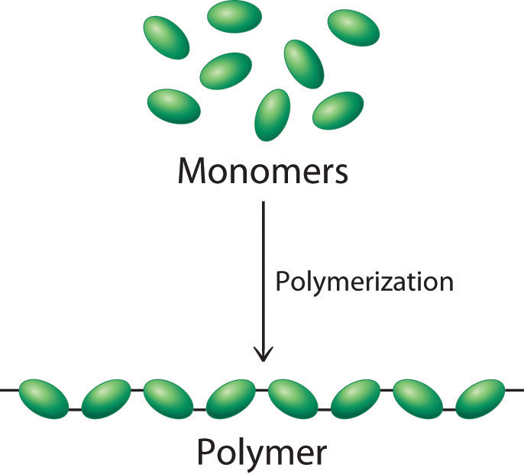

Slide 8
Macromolecules in Living Things
4 Types
1) Carbohydrates
2) Lipids
3) Proteins
4) Nucleic Acids

Slide 9
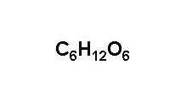
1) Carbohydrates
Monomer = Monosaccharide
Elements: Carbon, Hydrogen, Oxygen
Ratio =1:2:1
Function= Bodies’ main source of energy
Glucose

Slide 10
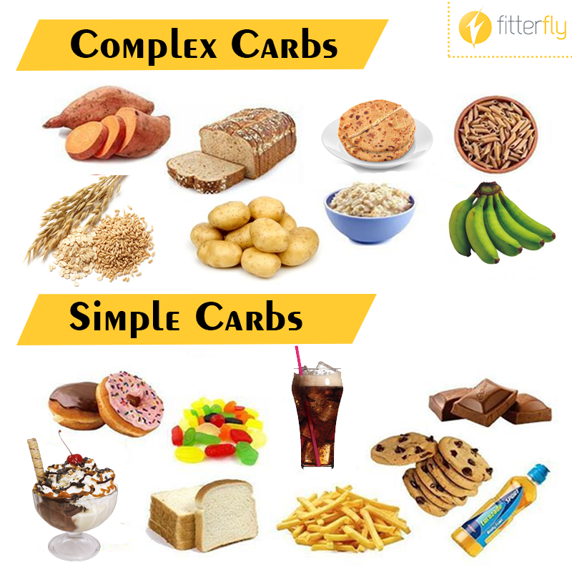
Foods High in Carbohydrates

Slide 11
Carbohydrates
Monosaccharide: single sugar
Example: glucose and fructose
Disaccharide: double sugar
Example: sucrose
Polysaccharide: Many sugars
Examples:
1) starch: used as energy storage by plants
2) cellulose: cell walls in plants

Slide 12
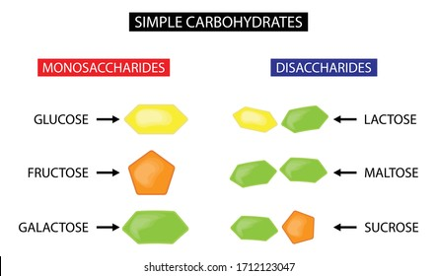
Monomer = monosaccharide

Slide 13
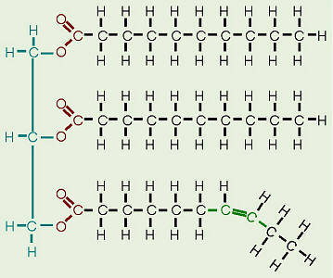
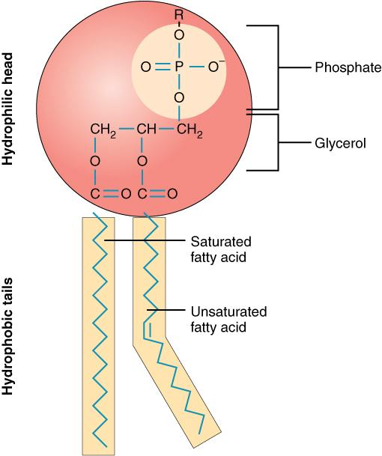
2. Lipids (Fats)
Monomer: Glycerol + Fatty Acid Tails
Made of: Carbon and Hydrogen and some oxygen

Slide 14
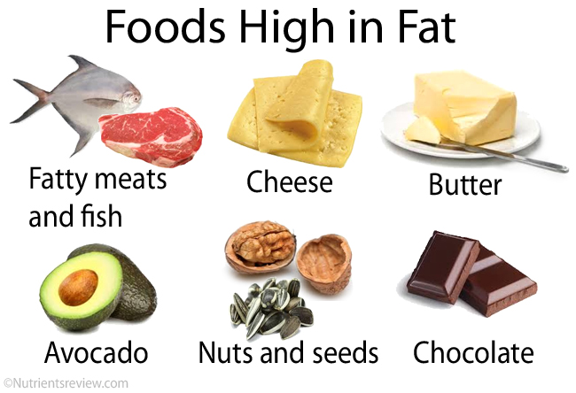
Lipids: (Fats/Oils)
Functions:
Long term energy storage
Insulation

Slide 15
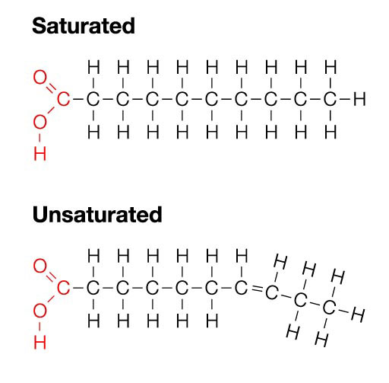
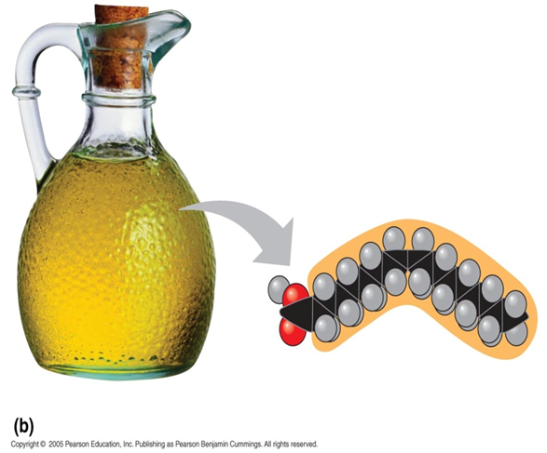
Lipids: Saturated & Unsaturated Fats
Structure:
Saturated Fats = No double bonds
Unsaturated Fats = 1 double bond

Slide 16
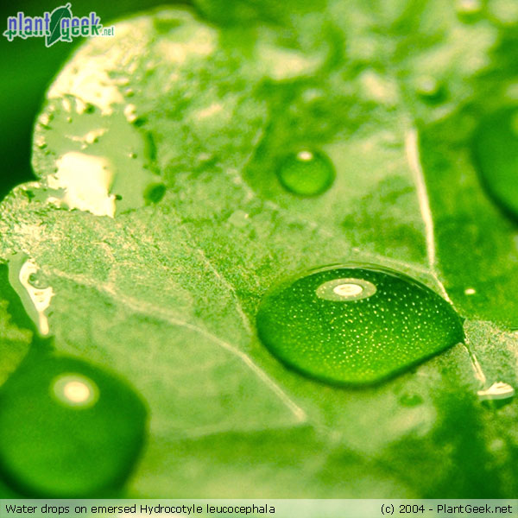
2. Lipids (Waxes)
Repel water
Ex: Fruits/Leaves

Slide 17
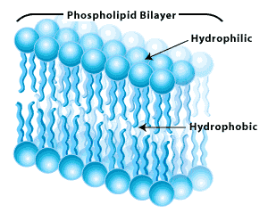
Lipids: Phospholipids
Responsible for the structure and function of the cell membrane.
Hydrophobic = “water-fearing” – repel water
Hydrophilic= “ water loving” – Attracts water

Slide 18
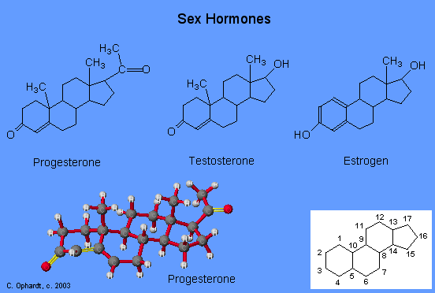
Lipids: Steroids + Cholesterol
Act as chemical messengers
Cholesterol helps in the formation of:
Vitamin D
Hormones such as estrogen & testosterone

Slide 19
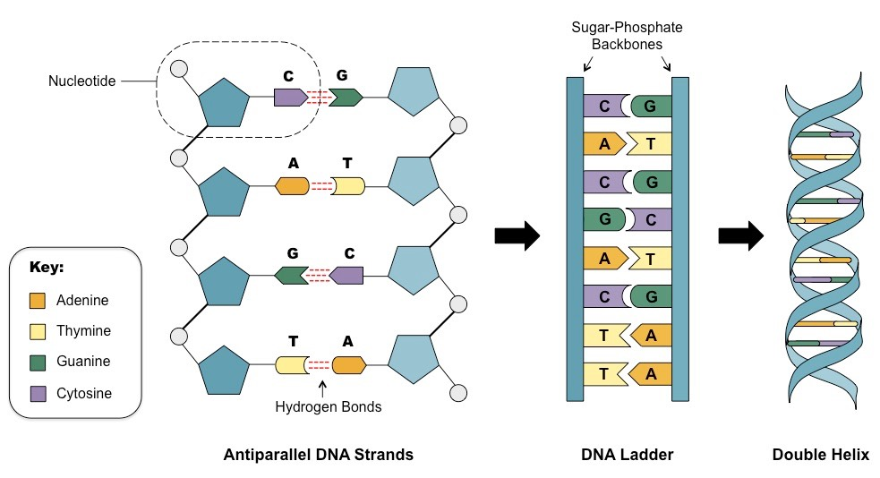
3. Nucleic Acids
Monomer: Nucleotide

Slide 20
3. Nucleic Acids
Elements: C, H, O, N, and P
Function: store & transmit genetic information
Nucleotide: monomer of a nucleic acid
A phosphate
A nitrogenous base
A ribose sugar

Slide 21
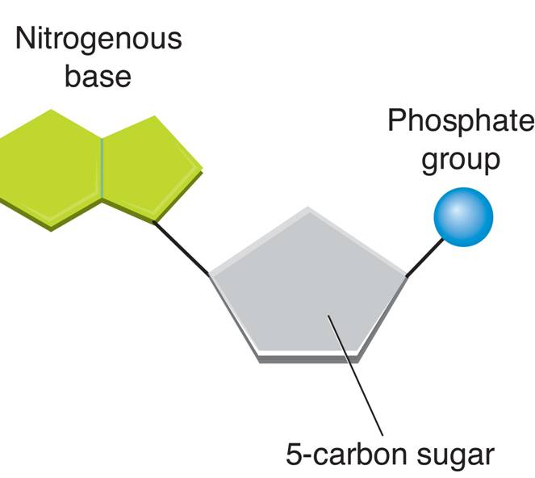
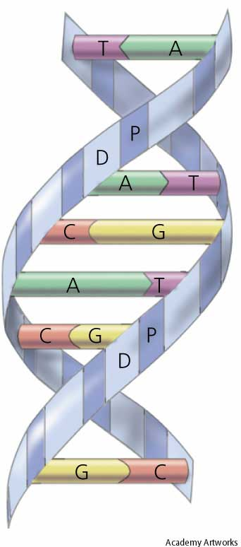
3. Nucleic Acids
Nucleotide
DNA

Slide 22
4. Proteins
Monomer: Amino Acids
Made of: C,H, O,N, and sometimes S
Functions:
1) Structure (hair, nails)
2) Transport (hemoglobin in blood)
3) Movement (muscle fibers)
4) Defense (antibodies)
5) Regulating Cell Functions (hormones and enzymes)

Slide 23
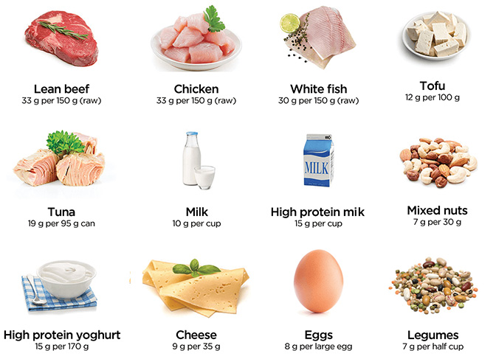
Foods High in Protein

Slide 24
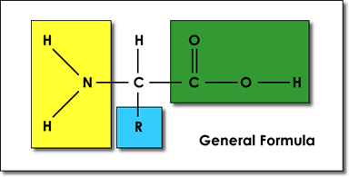
4. Proteins
Amino Acids : Monomers of proteins
Consists of a central Carbon atom bonded to 4 groups
4 Groups
1) Hydrogen Atom
2) Amino Group
3) Carboxyl Group
4) R group (changes in each Amino Acid!)

Slide 25
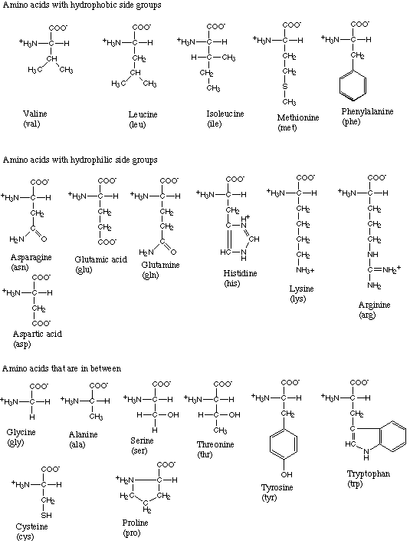
4. Proteins
Amino acids are joined together by peptide bonds
There are 20 different amino acids – Most are found only in animal products

Slide 26
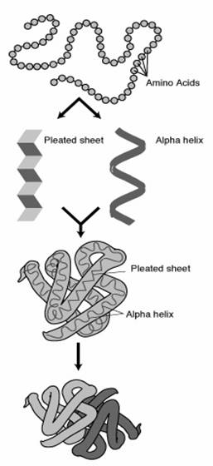
4. Proteins
Primary = order of amino acids in a chain
Secondary = amino acid chain folded into a
3-D structure
Tertiary = usually globular
Quaternary = Proteins combine with other proteins

Slide 27
Macromolecule Rap

