Slide 1
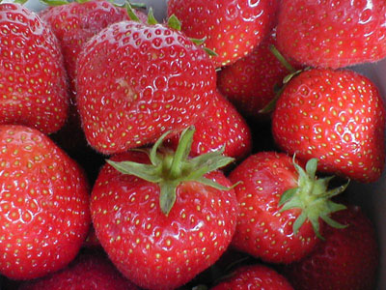
DNA Extraction from …

Slide 2
Is DNA in My Food???
DNA is present in the cells of all living organisms.
The process of extracting DNA from a cell is the first step for many laboratory procedures in biotechnology.
Scientist must be able to separate DNA gently enough so that the DNA does not denature (break up).

Slide 3
DNA Facts
Each cell contains 9 feet of DNA
In an average meal, you EAT approximately 55,000,000 cells
This is equal to approximately 93,205 miles of DNA

Slide 4
DNA
DNA is found in the nucleus of all eukaryotic cells
Most cells have the diploid 2n chromosome number
Many plants are polyploid (contain several sets of chromosomes)
Strawberries are octaploid 8n

Slide 5
DNA
DNA is enclosed in a nuclear and a cell membrane made of phospholipids
DNA is also coiled around proteins
The phospholipid layer, the organelles and the proteins must be removed to see DNA

Slide 6
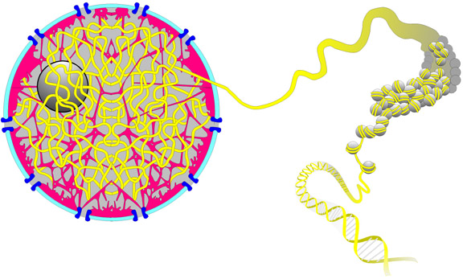
NUCLEUS with DNA

Slide 7
To Extract DNA, You Must Remove …
Cell membrane
Cytoplasm
Organelles
Nuclear membrane
Proteins

Slide 8
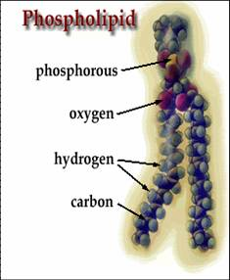
Cell Membrane
Cell membranes are made of phospholipids
Phospholipids will not dissolve in water – they are lipids

Slide 9
What do we need to dissolve lipids?
What do you use in your home to remove oils from your hands or your dishes?
SOAP or DETERGENT!

Slide 10
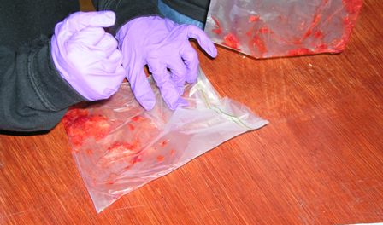
How Do I Begin?
Place the strawberry in a zip lock bag and remove the air
Squash the berry with your hand to begin the process

Slide 11
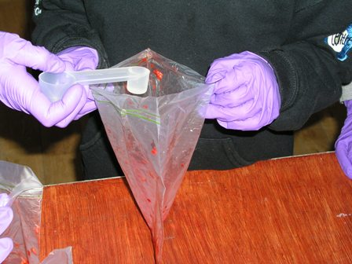
Soap & Detergent
Add the extraction buffer solution to the strawberry
This solution can then punch holes in the nuclear and cell membranes
The soapy solution also helps removes proteins

Slide 12
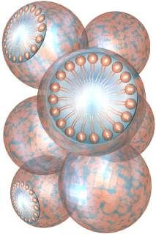
Soap & Detergent
Soap gathers between oil and water capturing the oil in a bubble called a micelle
When you wash your hands, the soap carries the oils away
Dawn dishwashing works BEST to remove phospholipid membranes

Slide 13
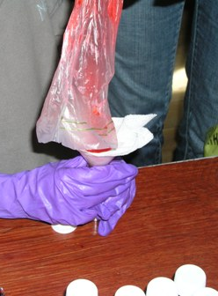
Extracting the DNA
Separate the contents of the cell (organelles, cytoplasm, nuclear membrane ect) from the DNA
The larger cell parts can be removed by filtering the solid from the liquid

Slide 14
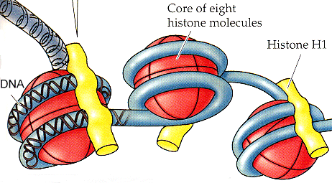
DNA is tightly coiled around proteins called histones
Proteins must be removed to see DNA

Slide 15
Extracting DNA
To see DNA, it must be extracted or “spooled” from the remaining liquid you filtered
DNA dissolves in water, but NOT in alcohol
Add COLD ALCOHOL will cause DNA to precipitate (separate out) from the liquid filtrate

Slide 16
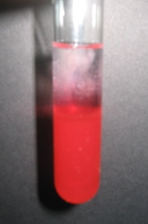
Collecting the DNA
The DNA will appear as a white precipitate once the alcohol is added
HOLD THE TUBE by the TOP, not the bottom so the DNA strands won’t fragment from the heat of your hands!

Slide 17
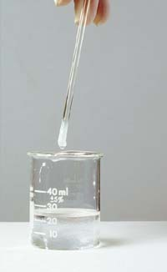
Spooling the DNA
DNA is sticky and will adhere to other surfaces
Use a stirring rod to spool (remove) the DNA by using a turning motion

Slide 18
DNA Necklace
You may put your extracted DNA into a micro centrifuge tube and create a necklace

