Slide 1
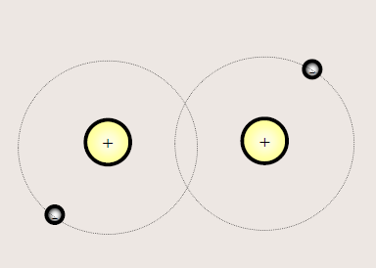
Chemical Bonds + Reactions

Slide 2
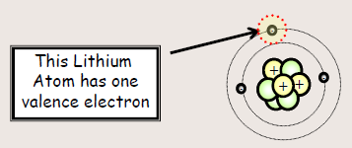
Chemical Bonds
A force of attraction that holds two atom together
Involves the valence electrons – the electrons on the outermost energy level of an atom
Valence Electrons – the electrons in the outermost energy level of an atom

Slide 3
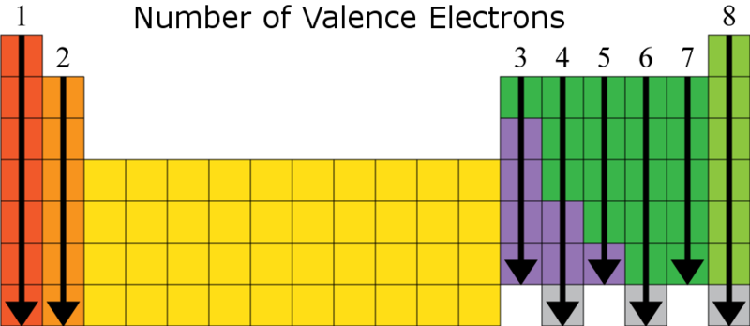
Using the Periodic Table to Find Valence Electrons

Slide 4
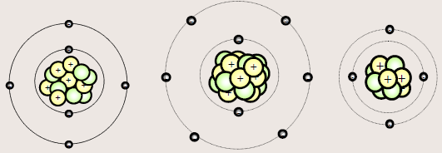
Count the Valence Electrons
Carbon
4 Valence Electrons
Oxygen
6 Valence Electrons
Beryllium
2 Valence Electrons

Slide 5
Who is faster you or your elbow partner?
Best 2 out of three
How many valence electrons does Lead (Pb) have?
How many valence electrons does Sulfur (S) have?
How many valence electrons does Xenon (Xe) have?

Slide 6
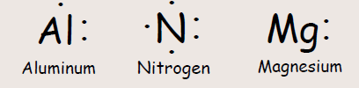
Lewis Structure
(Electron Dot Diagram)
Valence electrons are used to draw a Lewis structure of an atom
The symbol for the element surrounded by dots that are equal to the number of valence electrons and atom has
Examples:

Slide 7
Steps for Drawing Lewis Structure
Step 1: Find the total number of Valence electrons
Step 2: Determine the central atom (element there is only one of)
Step 3: Draw single bonds to the central atom
Step 4: Put all remaining valence electrons on the atom as lone pairs
Step 5: Turn lone pairs into double or triple bonds to give every atom an octet

Slide 8
Sharing Electrons
When electrons are shared, they are represented by a solid line.

Slide 9

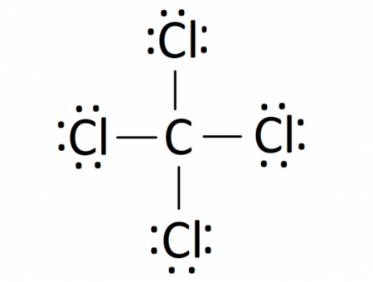
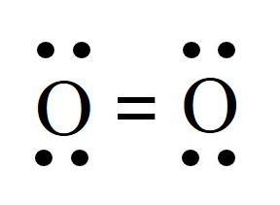
Practice Writing Lewis Dot Structures for Compounds
H₂
O₂
CCl₄

Slide 10

Octet Rule
Elements are happiest when the have a full valence shell.
Atoms will combine to form compounds in order to reach eight electrons in their valence shell

Slide 11
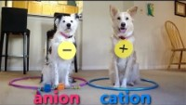
Chemical Bonds

Slide 12
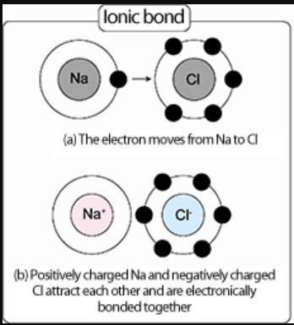
Ionic Bonds
Type of bond that occurs after a loss or gain of electrons
Forms between a metal and a non-metal

Slide 13
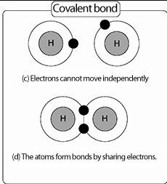
Covalent Bond
Two atoms are bonded together by sharing of electrons
Each pair of shared electrons creates a bond
Occurs between a non-metal and a non-metal

Slide 14
Sharing Electrons
When electrons are shared, they are represented by a solid line.

Slide 15
