Slide 1
DNA = Deoxyribonucleic Acid

Slide 2
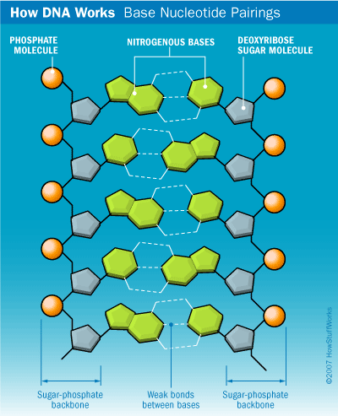
DNA Structure
DNA’s backbone is made of a sugar (Deoxyribose) and a phosphate
The rungs of DNA are made of 4 bases – Adenine, Guanine, Thymine, Cytosine
The DNA “ladder” is held together by hydrogen bonds
Notes:
Deoxyribonucleic acid- stands for Dna
Phosphate molecule is the backbone, then a sugar (deoxyribose), then a base pair, either purine or pyrimidine
Base pairing rules state that adenine always pairs with thymine and cytosine with guanine. A-T G-C

Slide 3
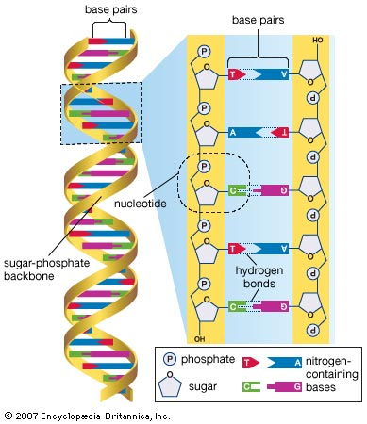
DNA Structure-Bases

Slide 4
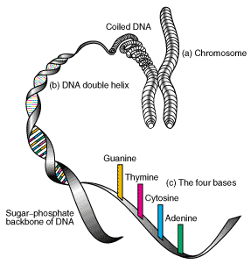
DNA Structure-Chromosomes
The DNA is coiled in the nucleus in chromosomes
Chromosomes carry the genetics of your ancestors

Slide 5
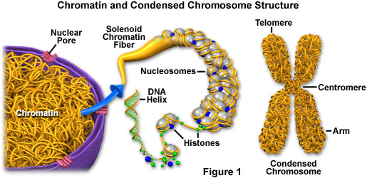
Chromosome Structure

Slide 6
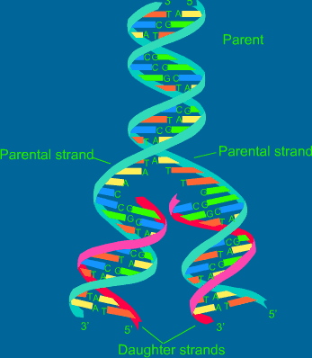
DNA Replication
DNA must be passed from cell to cell.
The copying of DNA is called replication
Once the entire process is complete two identical strands of DNA are formed.

Slide 7
Steps of DNA Replication
STEP 1:
DNA is unwound and hydrogen bonds are broken apart by the enzyme DNA helicase
STEP 2:
Two strands are separated by the enzyme DNA polymerase.

Slide 8
Steps of DNA Replication
STEP 3:
Complementary base pairs are brought to the original strand from the opposite end (antiparallel)
STEP 4:
DNA molecules are one part old strand one part new strand. (semi-conservative replication)
STEP 5:
Two identical strands of DNA are produced.

