Slide 1
Instructions on how to access Class Notebook Warm Up Section

Slide 2
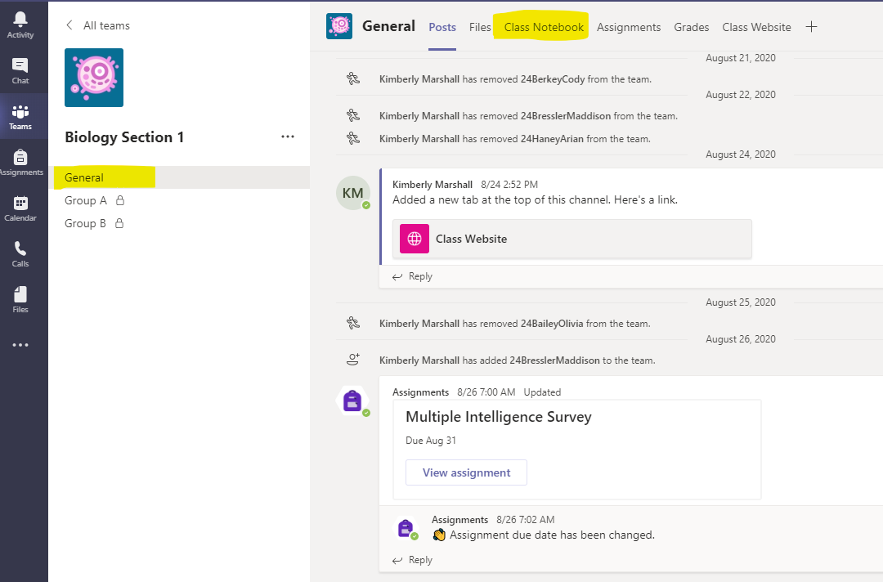
1. Choose your class from the Teams home page 2. Click General 3. Click Class Notebook

Slide 3
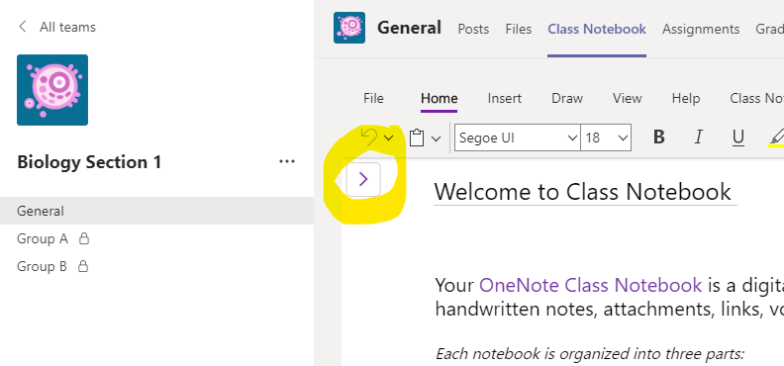
1. Click the purple arrow to access the drop down menu

Slide 4
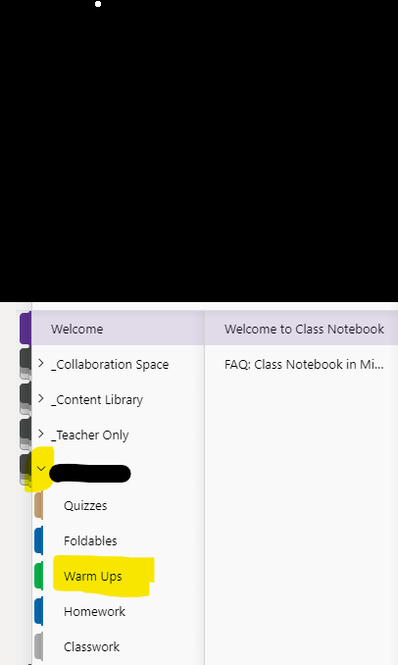
1. Click you name to access another drop down menu 2. Choose Warm Ups

Slide 5
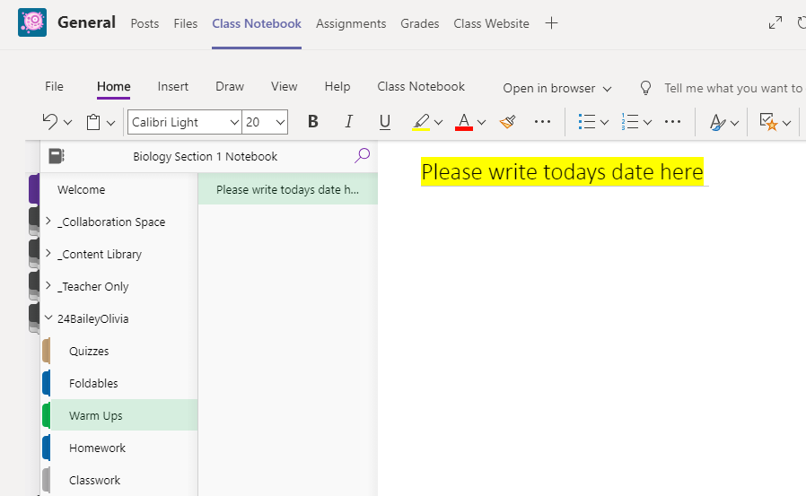
1. Write the date as the heading
1.
2.
3.

Slide 6
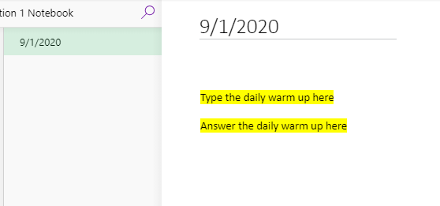
2. Type the warm up for the day 3. Answer the warm up

Slide 7
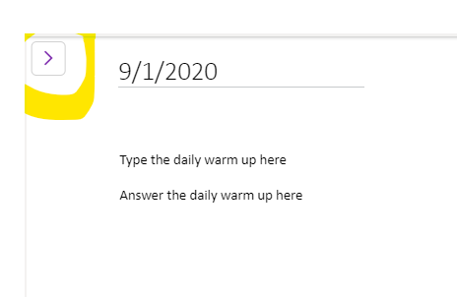
1. Click the purple Arrow

Slide 8
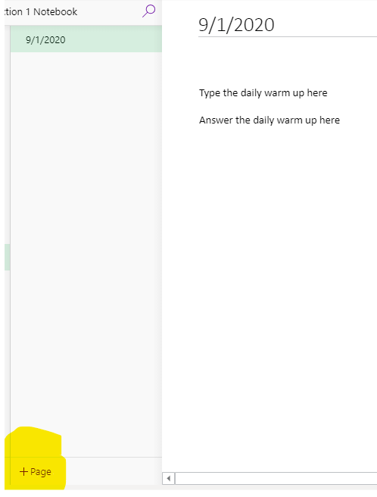
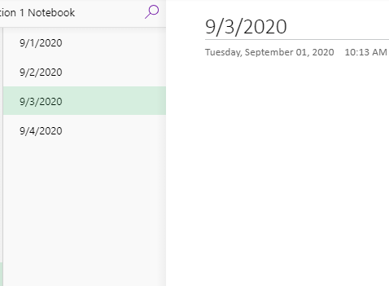
1. Click the + page and create a new page for each warm up

