Slide 1
Measuring Hints

Slide 2
Units of Measurement
Measurement | Units | Abbreviation
VOLUME | Milliliters | mL
LENGTH | Centimeters | cm
MASS | Grams | g

Slide 3
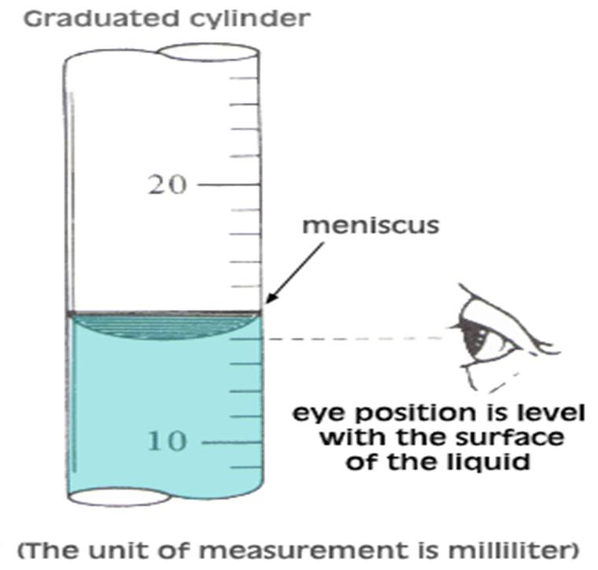
Measuring volume of liquid
When measuring, be sure your eye is level with the surface of the liquid

Slide 4
Reading the Meniscus
Use the graduations (lines) to find all certain digits
Estimate one final digit
What is the measurement?
21.5 mL

Slide 5
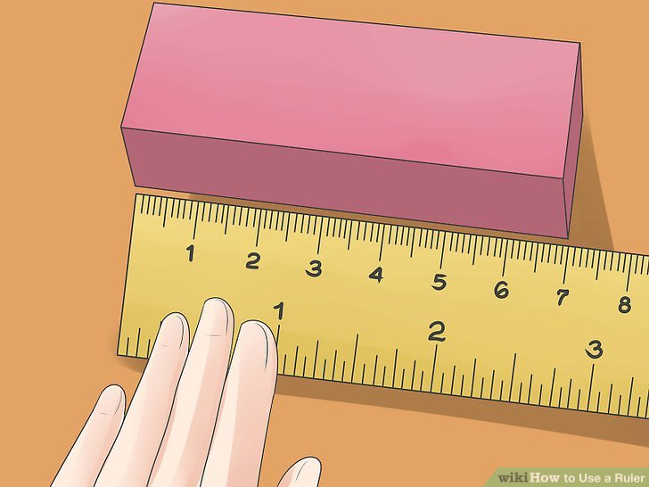
Measuring length
Find the centimeter lines on a ruler.
Place the zero end of your ruler at the end of your object.
Move to the opposite side of the object you are measuring
Measure one uncertain digit

Slide 6
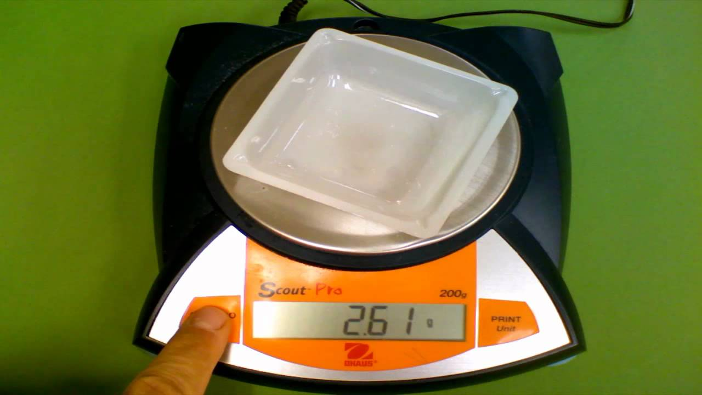
Measuring mass
Turn on the balance
Hit the tare button
Make sure you are measuring in grams
Place the object on the balance
*If using a weigh dish, you must subtract the mass of the weight boat from the final mass

