Slide 1
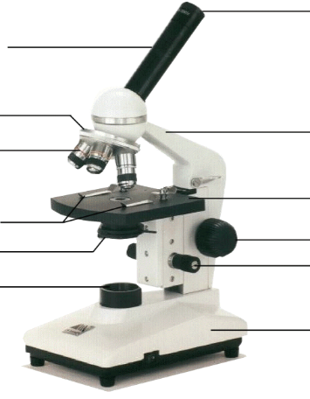
Light Microscope
Eyepiece
Body Tube
Nosepiece
Objective Lens
Arm
High Power
Stage
Stage Clip
Coarse Adjustment
Diaphragm
Fine Adjustment
Light
Base
Notes:
This is the exact version of the microscope used in class. Students will be identifying the parts on the microscopes at their desks as we go along and what their functions are.

Slide 2
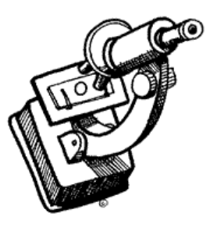
Using the light microscope
General Procedures
Sanitize you microscope before beginning.
Plug your microscope. If yours does not turn on, make sure the breaker is switched on the outlet.
Be sure the scanning objective (shortest lens) in in place
Place a slide on the stage
4. Store microscope with cover and cord neatly
Notes:
Give students a slide from the “common things” set, each student will practice focusing and changing objectives.

Slide 3
1. Always start with the scanning objective. Use the Coarse Knob to refocus. If you haven't focused on this level, you will not be able to move to the next level.
2. Once you've focused on Scanning, switch to Low Power.
Refocus! You may also have to adjust the light intensity
3. Now switch to High Power. At this point, ONLY use the fine adjustment knob to focus specimens.
Focusing Specimen
Notes:
Give students a slide from the “common things” set, each student will practice focusing and changing objectives.

Slide 4
Recap
1. Scanning --> use coarse knob
2. Low power --> use coarse knob
3. High power --> use fine knob
DO NOT SKIP STEPS!!!!

Slide 5
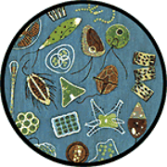
Using High Power
Your slide MUST be focused on low power before attempting to use high power
Click the nosepiece to the longest objective
Do NOT use the Coarse Focusing Knob, this could crack the slide or the lens
Use the Fine Focus Knob to focus the slide
Notes:
Have students exchange slides so they can look at different things, walk them through using the high power objective to focus slides. Emphasize not using the coarse objective during this process, as it will crack the slides.

Slide 6
Your microscope has 3 magnifications: Scanning, Low and High. Each objective will have written the magnification. In addition to this, the ocular lens (eyepiece) has a magnification. The total magnification is the ocular x objective
Magnification

Slide 7
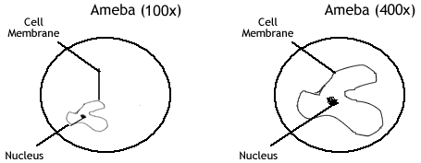
1. Use pencil - you can erase and shade areas
2. All drawings should include clear and proper labels (and be large enough to view details). Drawings should be labeled with the specimen name and magnification.
3. Labels should be written on the outside of the circle. The circle indicates the viewing field as seen through the eyepiece, specimens should be drawn to scale - ie..if your specimen takes up the whole viewing field, make sure your drawing reflects that.
Drawing Specimen

Slide 8
Troubleshooting
1. Image is too dark!
Adjust the diaphragm, make sure your light is on.
2. There's a spot in my viewing field, even when I move the slide the spot stays in the same place!
Your lens is dirty. Use lens paper, and only lens paper to carefully clean the objective and ocular lens. The ocular lens can be removed to clean the inside. The spot is probably a spec of dust.
3. I can't see anything under high power!
Remember the steps, if you can't focus under scanning and then low power, you won't be able to focus anything under high power. Start at scanning and walk through the steps again.
4. Only half of my viewing field is lit, it looks like there's a half-moon in there!
You probably don't have your objective fully clicked into place..

Slide 9
Making a Wet Mount
1. Gather a thin slice/ piece of whatever your specimen is. If your specimen is too thick, then the coverslip will wobble on top of the sample like a see-saw, and you will not be able to view it under High Power.
2. Place ONE drop of water directly over the specimen. If you put too much water, then the coverslip will float on top of the water, making it hard to draw the specimen, because they might actually float away. (Plus too much water is messy)
3. Place the cover slip at a 45 degree angle (approximately) with one edge touching the water drop and then gently let go. Performed correctly the coverslip will perfectly fall over the specimen.
Do not drop cover slip vertically, set one edge down and let the other side drop.

Slide 10
Clean Up
Store microscopes with the scanning objective in place.
Wrap cords and cover microscopes. *Double check to make sure you didn't leave a slide on the stage
Wash slides in the sinks and dry them, placing them back in the slide boxes to be used later.
4. Throw coverslips away. (these are not reusable)
*Be careful not to drop these in the sink, they can clog drain.
5. Place microscopes in their designated location (probably a cabinet)

Slide 11
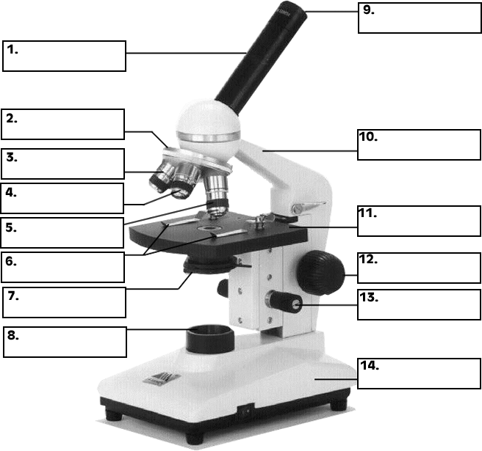
Practice Labeling the Parts

